Slide 1
Session 14 :Menus
Module 4.3 : Android

Slide 2
Learning Objectives
At the end of the session successful participants will be able to
Describe android menus.
Learn different types of Menus:
Create Options Menu Example
Create Context Menu Examples
Implement Enhance Option in Context Menu
Create App Using Menus that include Icons & Text
Create Submenus

Slide 3
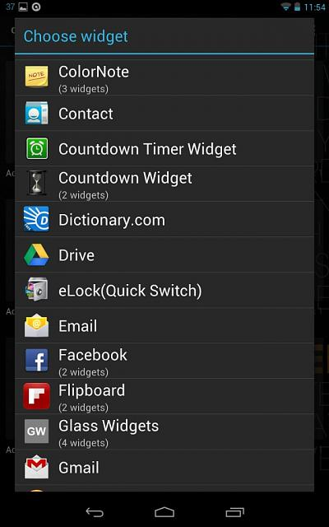
Menus
Menus in Android

Slide 4
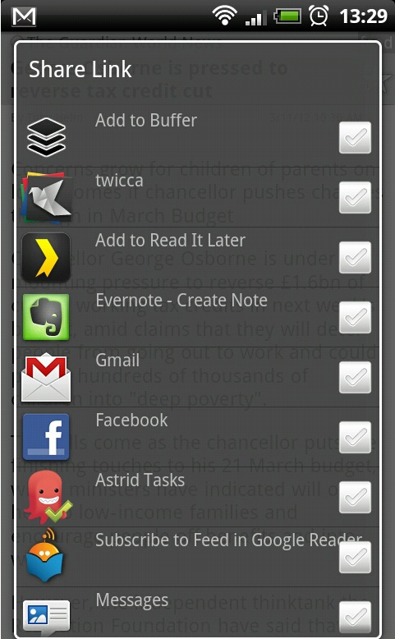

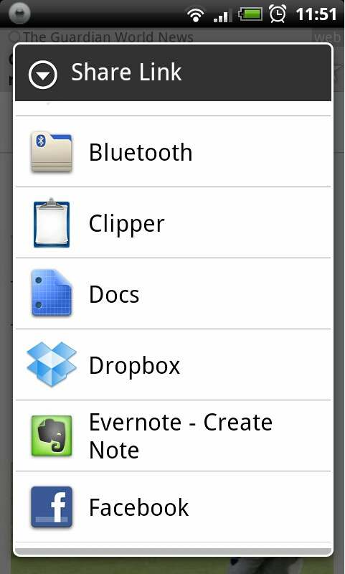
Menus
Menus in Android
Menus expose apps functionality without consuming ‘much’ view space.

Slide 5

Menus
Types of Menus
Android provides two types of menu known as: options menu and context menu.
The options menu is triggered by pressing the hardware Menu button on the device

Slide 6
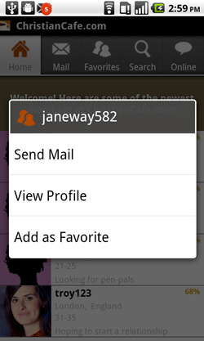
Menus
Types of Menus
Android provides two types of menu known as: options menu and context menu.
The context menu is raised by a tap-and-hold on the widget associated to the menu

Slide 7
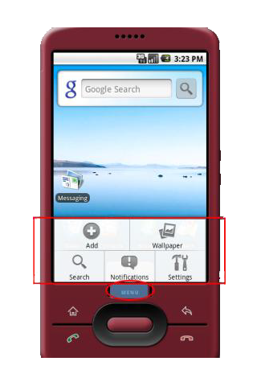
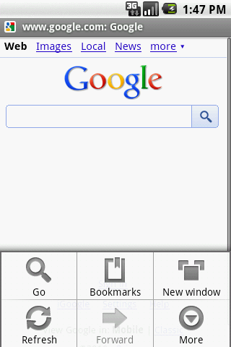
Menus
Types of Menus: Options Menu Example
Options available in this context
Press Menu button
A max of six entries per menu. Excess will be displayed as part of the More option

Slide 8
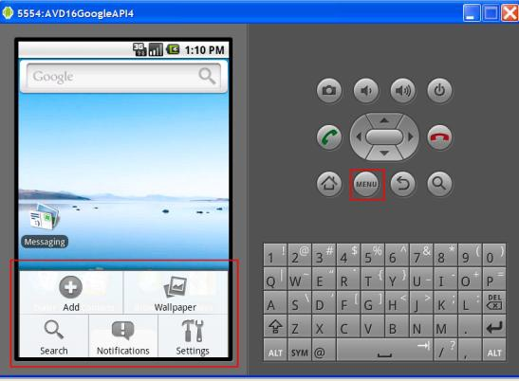
Menus
Types of Menus: Options Menu Example
Available Options in this context
Press Menu button

Slide 9

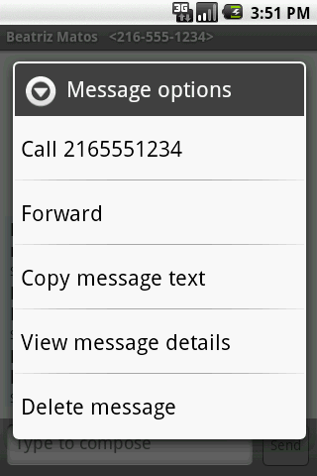
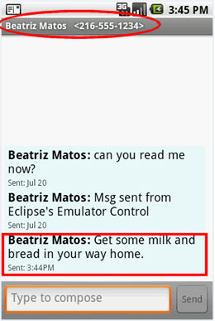
Menus
Types of Menus: Context Menu Example
Dealing with SMS (text-messages) by using the built-in Messaging app’s context menu
Available Options
Tap & Hold

Slide 10
Menus
Types of Menus
Option and Context Menus may include:
Texts
Check Boxes
Icons
Sub-menus
Radio Buttons
Short-cut Keys

Slide 11
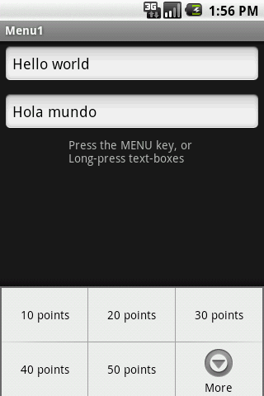
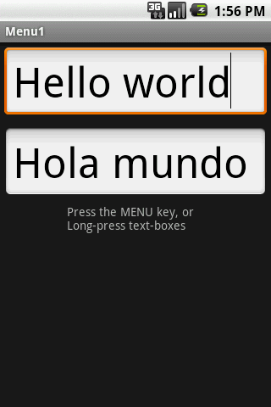
Menus
Types of Menus: Options Menu Example
In this application the Option menu offers a way of changing the text size (on both EditText boxes)
Click on Menu button to see size options
After choosing option: 50 points

Slide 12
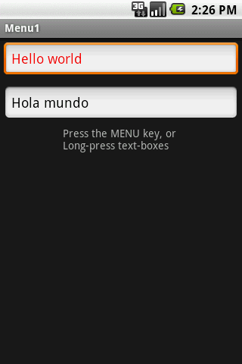
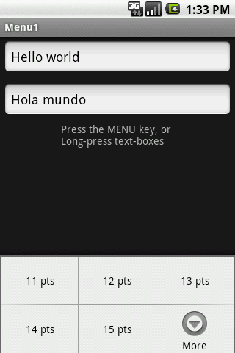
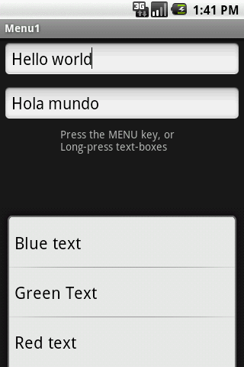
Menus
Types of Menus: Options Menu Example
Up to six options will Be displayed on the Option menu. If there are more than six options pushing the More button will show the rest
Click the More button to see additional options
Additional choices of the Option menu

Slide 13
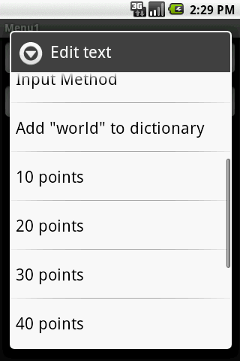
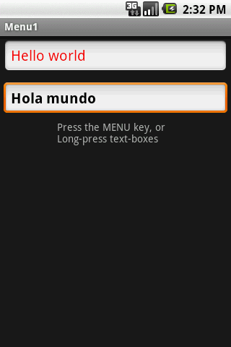
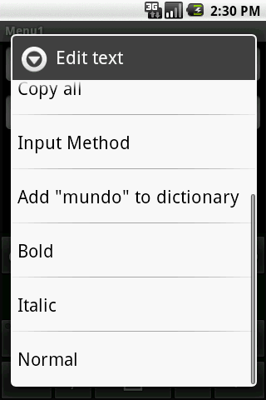
Menus
Types of Menus: Contexts Menu Example
Each view could have an associated Context Menu
Long-press a textbox to invoke its Context Menu

Slide 14
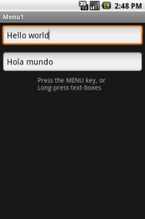
Menus
Types of Menus: Options And Context Menu Examples
The app shows two text boxes. Menus are used to change text’s size, color, and style.
<?xml version="1.0" encoding="utf-8"?>
<LinearLayoutxmlns:android="http://schemas.android.com/apk/res/android"
android:orientation="vertical"
android:layout_width="fill_parent"
android:layout_height="fill_parent“ >
<EditText
android:id="@+id/etMessage1"
android:text="Hello world"
android:layout_width="fill_parent"
android:layout_height="wrap_content"
android:layout_margin= "5dp" />

Slide 15
Menus
Types of Menus: Options And Context Menu Examples
The app shows two text boxes. Menus are used to change text’s size, color, and style.
Package cis493.matos.menu;
// using Menus (Option & Context)
Import android.app.Activity; …
Public class Menu1Act1 extendsActivity {
EditTextetMessage1;
EditTextetMessage2;
Integer[] arrayPointSize= {10, 20, 30, 40, 50};
@Override
Public void onCreate(Bundle savedInstanceState) {
super.onCreate(savedInstanceState);
setContentView(R.layout.main);
etMessage1= (EditText)findViewById(R.id.etMessage1);

Slide 16
Menus
Types of Menus: Options And Context Menu Examples
The app shows two text boxes. Menus are used to change text’s size, color, and style.
etMessage2= (EditText)findViewById(R.id.etMessage2);
// you may register an individual context menu for each view
registerForContextMenu(etMessage1);
registerForContextMenu(etMessage2);
} //onCreate12
// set the option menu for the current activity
@Override
Public boolean onCreateOptionsMenu(Menu menu) {
// only one Option menu per activity
populateMyFirstMenu(menu);
returnsuper.onCreateOptionsMenu(menu);
}

Slide 17
Menus
Types of Menus: Options And Context Menu Examples
The app shows two text boxes. Menus are used to change text’s size, color, and style.
// detect what view is calling and create its context menu
@Override
Public void onCreateContextMenu(ContextMenumenu, View v,
ContextMenuInfomenuInfo) {
super.onCreateContextMenu(menu, v, menuInfo);
// decide what context menu needs to be made
if(v.getId() == etMessage1.getId())
// create a menu for etMessage1 box
populateMyFirstMenu(menu);
if(v.getId() == etMessage2.getId()){
// create a menu for etMessage2 box
populateMySecondMenu(menu);}} //onCreateContextMenu

Slide 18
Menus
Types of Menus: Options And Context Menu Examples
The app shows two text boxes. Menus are used to change text’s size, color, and style.
Private void populateMyFirstMenu(Menu menu){
intgroupId= 0; intorder= 0;
//arguments: groupId, optionId, order, title
menu.add(groupId, 1, 1, "10 points");
menu.add(groupId, 2, 2, "20 points");
menu.add(groupId, 3, 3, "30 points");
menu.add(groupId, 4, 4, "40 points");
menu.add(groupId, 5, 5, "50 points");
menu.add(groupId, 6, 8, "Red text");
menu.add(groupId, 7, 7, "Green Text");
menu.add(groupId, 8, 6, "Blue text");
} //populateMyMenu

Slide 19
Menus
Types of Menus: Options And Context Menu Examples
The app shows two text boxes. Menus are used to change text’s size, color, and style.
Private void populateMySecondMenu(Menu menu){
intgroupId= 0; intorder= 0;
//arguments: groupId, optionId, order, title
menu.add(groupId, 9, 1, "Bold");
menu.add(groupId, 10, 2, "Italic");
menu.add(groupId, 11, 3, "Normal");}//populateMySecondMenu
@Override
publicbooleanonContextItemSelected(MenuItemitem) {
return(applyMenuOption(item));
}@Override
publicbooleanonOptionsItemSelected(MenuItemitem) {
return(applyMenuOption(item));}

Slide 20
Menus
Types of Menus: Options And Context Menu Examples
The app shows two text boxes. Menus are used to change text’s size, color, and style.
Private boolean applyMenuOption(MenuItemitem){
intmenuItemId= item.getItemId(); // 1, 2, 3, ...11
String strMsg2 = etMessage2.getText().toString();
if(menuItemId<= 5) {
// first five option are for setting text size
intnewPointSize= arrayPointSize[menuItemId-1];
etMessage1.setTextSize(newPointSize);
etMessage2.setTextSize(newPointSize);
}
else{
// either change color on text1 or style on text2
if(menuItemId== 6)

Slide 21
Menus
Types of Menus: Options And Context Menu Examples
The app shows two text boxes. Menus are used to change text’s size, color, and style.
etMessage1.setTextColor(0xffff0000); // red
else if(menuItemId== 7)
etMessage1.setTextColor(0xff00ff00); // green
else if(menuItemId== 8)
etMessage1.setTextColor(0xff0000ff); // blue
else if(menuItemId== 9)
etMessage2.setText(beautify(strMsg2, "BOLD")); //bold
else if(menuItemId== 10)
etMessage2.setText(beautify(strMsg2, "ITALIC")); //italic
else if(menuItemId== 11)
etMessage2.setText(beautify(strMsg2, "NORMAL")); //normal
}returnfalse;} //applyMenuOption

Slide 22
Menus
Types of Menus: Options And Context Menu Examples
The app shows two text boxes. Menus are used to change text’s size, color, and style.
// changing text style using HTML formatting
//Spanned is text to which you could add formatting features
private Spanned beautify (String originalText, String selectedStyle){Spanned answer = null;
if(selectedStyle.equals("BOLD"))
answer = Html.fromHtml("<b>"+ originalText+"</b");
elseif(selectedStyle.equals("ITALIC"))
answer = Html.fromHtml("<i>"+ originalText+"</i>");
elseif(selectedStyle.equals("NORMAL"))
answer = Html.fromHtml("<normal>"+ originalText+"</normal");
Returnanswer;} //beautify
} //Menu1Act1

Slide 23
Menus
Comments on Creating An Option & Context Menu
Indicate which widget(s) on your activity have context menus. To do this, call registerForContextMenu(theWidget) supplying the View that is the widget needing a context menu.
Step 1
Implement onCreateContextMenu(…), populate your menu adding text, icons, etc. to the different options. Use input menu parameter to determine which menu to build (assuming your activity has more than one).
Step 2

Slide 24
Menus
Comments on Creating An Option & Context Menu
Note:
The onCreateContextMenu() method gets the ContextMenu itself, the View the context menu is associated with, and a ContextMenu.ContextMenuInfo, which tells you which item in the list the user did the tap-and-hold over, in case you want to customize the context menu based on that information

Slide 25
Menus
Comments on Creating An Option & Context Menu
onCreateContextMenu() is called each time the context menu is requested.
Unlike the options menu (which is only built once per activity), context menus are discarded once they are used or dismissed.
To find out when a context menu choice was chosen, implement onContextItemSelected() on the activity.

Slide 26
Menus
Comments on Creating An Option & Context Menu
Our Example1 implementations of
onOptionsItemSelected() (for options menu selections), and
onContextItemSelected() (for context menu selections)
delegate to the applyMenuChoice(…) method where actions associated to the choices made is implemented
@Override
Public boolean onOptionsItemSelected(MenuItemitem) {
return(applyMenuChoice(item));}
@Override
Public boolean onContextItemSelected(MenuItemitem) {
return(applyMenuChoice(item));}

Slide 27
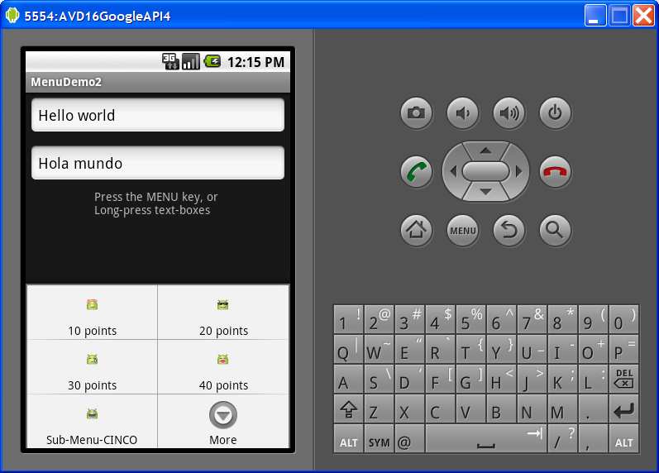
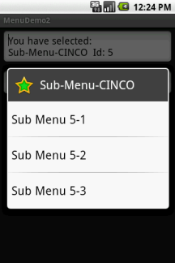
Menus
Enhance Option & Context Menu: Example
This extension of the previous example adds icons and links to the Option Menu entries, as well as a sub-menu list tied to one the option menu buttons.
Click on Sub Menu to see additional options

Slide 28
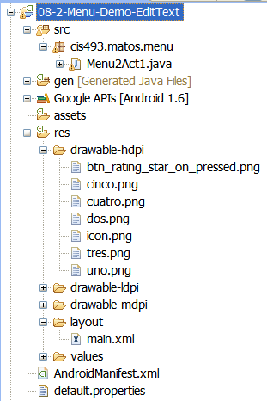
Menus
Enhance Option & Context Menu: Example
This extension of the previous example adds icons and links to the Option Menu entries, as well as a sub-menu list tied to one the option menu buttons.

Slide 29
Menus
Enhance Option & Context Menu: Example
Note: Replace the method populateMyFirstMenu with the following code in previous example
Private void populateMyFirstMenu(Menu menu){
intgroupId= 0;
//arguments: groupId, optionId, order, title
MenuItemitem1 = menu.add(groupId, 1, 1, "10 points");
MenuItemitem2 = menu.add(groupId, 2, 2, "20 points");
MenuItemitem3 = menu.add(groupId, 3, 3, "30 points");
MenuItemitem4 = menu.add(groupId, 4, 4, "40 points");
//MenuItemitem5 = menu.add(groupId, 5, 5, "50 points");
MenuItemitem6 = menu.add(groupId, 6, 8, "Red text");
MenuItemitem7 = menu.add(groupId, 7, 7, "Green Text");
MenuItemitem8 = menu.add(groupId, 8, 6, "Blue text");
//set icons

Slide 30
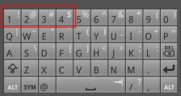
Menus
Enhance Option & Context Menu: Example
Note: Replace the method populateMyFirstMenu with the following code in previous example
item1.setIcon(R.drawable.uno);
item2.setIcon(R.drawable.dos);
item3.setIcon(R.drawable.tres);
item4.setIcon(R.drawable.cuatro);
// shortcuts using device’s keyboard-keypad
// on a G1 open slide open the keyboard and
// type letter u (same as pressing menu UNO)
item1.setShortcut('1', '1');
item2.setShortcut('2', '2');
item3.setShortcut('3', '3');
item4.setShortcut('4', '4');

Slide 31
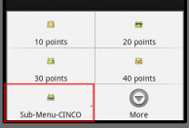
Menus
Enhance Option & Context Menu: Example
Note: Replace the method populateMyFirstMenu with the following code in previous example
//adding a sub-menu as fifth entry of this menu
// .addSubMenu(intgroupId, intitemId, intorder, CharSequencetitle)
intsmGroupId= 0; // don't care, same as Menu.NONE
intsmItemId= 5; // fifth element
intsmOrder= 5; // don't care, same as Menu.NONE
SubMenumySubMenu5 = menu.addSubMenu(smGroupId, smItemId, smOrder, "Sub-Menu-CINCO");

Slide 32
Menus
Enhance Option & Context Menu: Example
Note: Replace the method populateMyFirstMenu with the following code in previous example
mySubMenu5.setHeaderIcon(R.drawable.btn_rating_star_on_pressed);
mySubMenu5.setIcon(R.drawable.cinco);
// .add(intgroupId, intitemId, intorder, CharSequencetitle)
MenuItemsub51 = mySubMenu5.add(smGroupId,5,1,"Sub Menu 5-1");
MenuItemsub52 = mySubMenu5.add(smGroupId,5,2,"Sub Menu 5-2");
MenuItemsub53 = mySubMenu5.add(smGroupId,5,3,"Sub Menu 5-3");
} //populateMyFirstMenu

Slide 33
Menus
Enhance Option & Context Menu: Example
Note: Replace the method populateMyFirstMenu with the following code in previous example
Private boolean applyMenuOption(MenuItemitem){
intmenuItemId= item.getItemId(); //1, 2, 3, ...11
String strMsg2 = etMessage2.getText().toString();
if(menuItemId< 5) {
// first four options are for setting text size
intnewPointSize= arrayPointSize[menuItemId-1];
etMessage1.setTextSize(newPointSize);
etMessage2.setTextSize(newPointSize);
}
elseif(menuItemId== 5) {
// the sub-menu (attached to 5th item) is processed here
etMessage1.setText ( "You have selected: \n“+

Slide 34
Menus
Enhance Option & Context Menu: Example
Note: Replace the method populateMyFirstMenu with the following code in previous example
item.getTitle() + " Id: "+ menuItemId);
}
// either change color on text1 or style on text2
else if(menuItemId== 6)
etMessage1.setTextColor(0xffff0000); // red
else if(menuItemId== 7)
etMessage1.setTextColor(0xff00ff00); // green
else if(menuItemId== 8)
etMessage1.setTextColor(0xff0000ff); // blue
else if(menuItemId== 9)
etMessage2.setText(beautify(strMsg2, "BOLD")); //bold
else if(menuItemId== 10)

Slide 35
Menus
Enhance Option & Context Menu: Example
Note: Replace the method populateMyFirstMenu with the following code in previous example
etMessage2.setText(beautify(strMsg2, "ITALIC")); //italic
else if(menuItemId== 11)
etMessage2.setText(beautify(strMsg2, "NORMAL")); //normal
returnfalse;
} //applyMenuOption

Slide 36
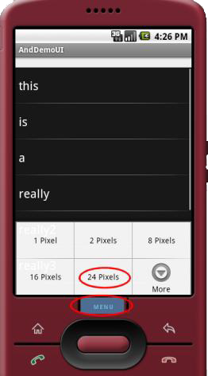
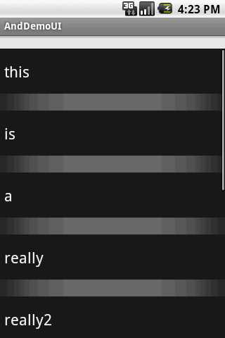
Menus
Option / Context Menu: More Examples - 1
After choosing option: 24 Pixels of row separation
Click on Menu to see spacing options

Slide 37
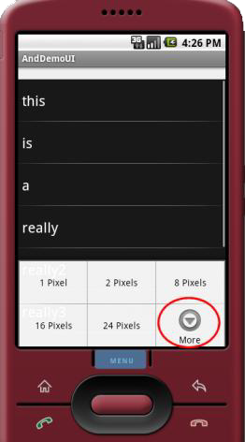
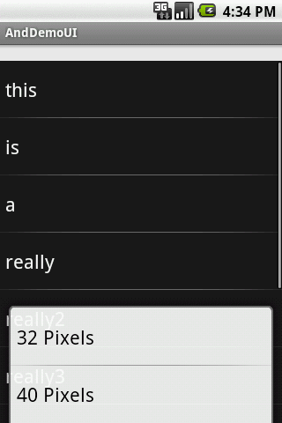
Menus
Option Menu: More Examples - 1
After choosing option: More a new menu is shown
Click on Menu to see spacing options

Slide 38
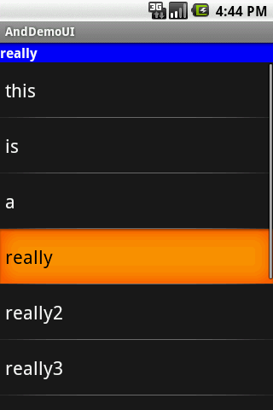
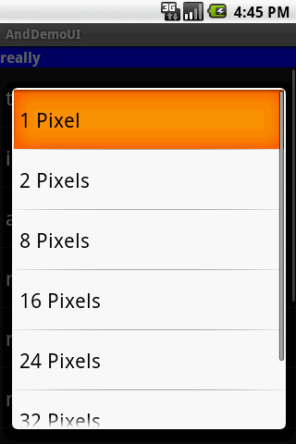
Menus
Context Menu: More Examples - 1
Click on Menu to see spacing options
Click on Menu to see spacing options

Slide 39
Menus
Creating an Option & Context Menu: More Examples - 2
<?xml version="1.0" encoding="utf-8"?>
<LinearLayoutxmlns:android="http://schemas.android.com/apk/res/android"
android:orientation="vertical"
android:layout_width="fill_parent"
android:layout_height="fill_parent" >
<TextView
android:id="@+id/selection"
android:layout_width="fill_parent"
android:layout_height="wrap_content"
android:background="#eeeeee"/>
<ListView
android:id="@android:id/list"
android:layout_width="fill_parent"
android:layout_height="fill_parent”

Slide 40
Menus
Creating an Option & Context Menu: More Examples - 2
android:drawSelectorOnTop="false"
/>
</LinearLayout>

Slide 41
Menus
Creating an Option & Context Menu: More Examples - 2
package cis493.demoui;
import android.os.Bundle;
import android.app.ListActivity;
import android.view.ContextMenu;
import android.view.Menu;
import android.view.MenuItem;
import android.view.View;
import android.widget.ArrayAdapter;
import android.widget.ListView;
import android.widget.TextView;
public class AndDemoUIextendsListActivity{
TextViewselection;
// data to be displayed in the ListView

Slide 42
Menus
Creating an Option & Context Menu: More Examples - 2
String[] items= { "this", "is", "a", "really", "really2", "really3", "really4", "really5", "silly", "list"};
public static final intEIGHT_ID= Menu.FIRST+ 1;
public static final intSIXTEEN_ID= Menu.FIRST+ 2;
public static final intTWENTY_FOUR_ID= Menu.FIRST+ 3;
public static final intTWO_ID= Menu.FIRST+ 4;
public static final intTHIRTY_TWO_ID= Menu.FIRST+ 5;
public static final intFORTY_ID= Menu.FIRST+ 6;
public static final intONE_ID= Menu.FIRST+ 7;
@Override
publicvoidonCreate(Bundle icicle) {
super.onCreate(icicle);
setContentView(R.layout.main);//show array data into list

Slide 43
Menus
Creating an Option & Context Menu: More Examples - 2
setListAdapter(newArrayAdapter<String>(
this,
android.R.layout.simple_list_item_1,
items));
selection= (TextView) findViewById(R.id.selection);//attach a ContextMenuto the Activity's ListViewregisterForContextMenu(getListView());
}
Public void onListItemClick(ListViewparent, View v,
intposition, longid) {
selection.setText(items[position]);
}
@Override
Public void onCreateContextMenu( ContextMenumenu, View v, ContextMenu.ContextMenuInfomenuInfo) {

Slide 44
Menus
Creating an Option & Context Menu: More Examples - 2
// if comment it out –no context menu is created
populateMenu(menu);
}@Override
publicbooleanonCreateOptionsMenu(Menu menu) {// if comment it out –no option menu is created
populateMenu(menu);
return(super.onCreateOptionsMenu(menu));
}// we will react to the events: either a click on the Menu button
// or a long ‘tap-and-hold’ to trigger Option Menu or Context Menu
@Override
publicbooleanonOptionsItemSelected(MenuItemitem) {
return( applyMenuChoice(item) );
}@Override

Slide 45
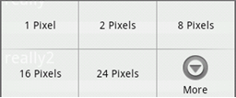
Menus
Creating an Option & Context Menu: More Examples - 2
Public boolean onContextItemSelected(MenuItemitem) {
return( applyMenuChoice(item) );}
privatevoidpopulateMenu(Menu menu) {
menu.add(Menu.NONE, ONE_ID, Menu.NONE, "1 Pixel");
menu.add(Menu.NONE, TWO_ID, Menu.NONE, "2 Pixels");
menu.add(Menu.NONE, EIGHT_ID, Menu.NONE, "8 Pixels");
menu.add(Menu.NONE, SIXTEEN_ID, Menu.NONE, "16 Pixels");
menu.add(Menu.NONE, TWENTY_FOUR_ID, Menu.NONE, "24 Pixels");
menu.add(Menu.NONE, THIRTY_TWO_ID, Menu.NONE, "32 Pixels");
menu.add(Menu.NONE, FORTY_ID, Menu.NONE, "40 Pixels");}
A max of six entries per menu. Excess will be displayed as part of the More option

Slide 46
Menus
Creating an Option & Context Menu: More Examples - 2
Private boolean applyMenuChoice(MenuItemitem) {
switch(item.getItemId()) {
caseONE_ID:
getListView().setDividerHeight(1);
return(true);
caseEIGHT_ID:
getListView().setDividerHeight(8);
return(true);
caseSIXTEEN_ID:
getListView().setDividerHeight(16);
return(true);
caseTWENTY_FOUR_ID:
getListView().setDividerHeight(24);
return(true);

Slide 47
Menus
Creating an Option & Context Menu: More Examples - 2
caseTWO_ID:
getListView().setDividerHeight(2);
return(true);
caseTHIRTY_TWO_ID:
getListView().setDividerHeight(32);
return(true);
caseFORTY_ID:
getListView().setDividerHeight(40);
return(true);
}
return(false);
}//applyMenuChoice
}//class

Slide 48
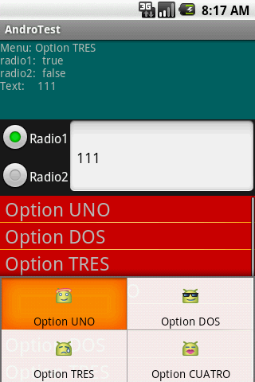
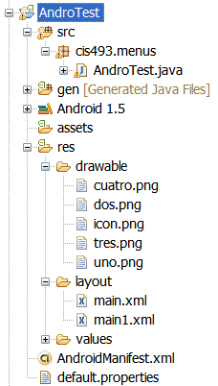
Menus
Another App Using Menus that include Icons & Text : Example - 3
This is a simple application designed around a TableLayout.
The first row shows a summary of the data collected from the screen.
The second row exposes a RadioGroup and a textBox.
icons
This Option Menu shows its options using text & icons
The third row shows a list of the calls made to the option and context menus.
layouts

Slide 49
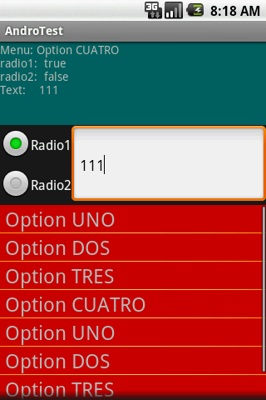
Menus
Another App Using Menus that include Icons & Text : Example - 3
Application’s Layout
Row1: TextView
Row2: RelativeLayout holding
EditText Box
EditText Box
Radio1
Radio2
Row3: ListView (acting as a Scrolling Container)

Slide 50
Menus
Another App Using Menus that include Icons & Text : Example - 3
Application’s Layout Hierarchy View
PhoneWindow$DecorView #0@43599778 NO_ID
LinearLayout #0@43599f38 NO_ID
FrameLayout #1@4359b8b0 id/content
TableLayout #0@4359bf98 id/my TableLayout
TableRow #0@4359c890 id/table Row 1
TextView #0@4359cc50 id/text0
TableRow #1@4359d180 id/table Row2
RelativeLayout #0@4359d5e8 d/my RelativeLayout
TableRow #2@435a09a0 id/table Row3
ListView #0@435a0e80 id/list 1
FrameLayout#0@4359a788
TextView #0@4359ad70 id/title
EditText #0@4359da80 id/text1
RadioGroup #1@4359ead8 id/myRadioGroup
RadioButton #0@4359f258 id/radio1
RadioButton#1@4359ff90 id/radio2
TextView#0@435b4258 id/text3
TextView #1@435b5018 id/text3

Slide 51
Menus
Another App Using Menus that include Icons & Text : Example - 3
Main Layout
<?xml version="1.0" encoding="utf-8"?><TableLayout
android:id="@+id/myTableLayout"
android:layout_width="fill_parent"
android:layout_height="fill_parent"
android:orientation="vertical"
android:stretchColumns="1,2,3"
xmlns:android="http://schemas.android.com/apk/res/android"
><TableRowandroid:id="@+id/tableRow1"
android:layout_width="fill_parent"
android:layout_height="wrap_content"
android:orientation="horizontal"
><TextView
android:id="@+id/text0”

Slide 52
Menus
Another App Using Menus that include Icons & Text : Example - 3
Main Layout
android:layout_width="fill_parent"
android:layout_height="100px"
android:background="#ff006666"
android:text="TextView"
android:layout_span="3"
>
</TextView>
</TableRow>
<TableRowandroid:id="@+id/tableRow2"
android:layout_width="fill_parent"
android:layout_height="wrap_content"
android:orientation="horizontal"
><RelativeLayout

Slide 53
Menus
Another App Using Menus that include Icons & Text : Example - 3
Main Layout
android:id="@+id/myRelativeLayout"
android:layout_width="wrap_content"
android:layout_height="wrap_content"
><EditText
android:id="@+id/text1"
android:layout_width="fill_parent"
android:layout_height="wrap_content"
android:hint="Type something..."
android:textSize="18sp"
android:layout_alignTop="@+id/myRadioGroup"
android:layout_alignBottom="@+id/myRadioGroup"
android:layout_toRightOf="@+id/myRadioGroup"
android:padding="10px”

Slide 54
Menus
Another App Using Menus that include Icons & Text : Example - 3
Main Layout
android:paddingLeft="20px“></EditText>
<RadioGroup
android:id="@+id/myRadioGroup"
android:layout_width="wrap_content"
android:layout_height="wrap_content"
android:orientation="vertical"
android:layout_alignParentTop="true"
android:layout_alignParentLeft="true"
>
<RadioButton
android:id="@+id/radio1"
android:layout_width="wrap_content"
android:layout_height="wrap_content”

Slide 55
Menus
Another App Using Menus that include Icons & Text : Example - 3
Main Layout
android:text="Radio1"
></RadioButton>
<RadioButton
android:id="@+id/radio2"
android:layout_width="wrap_content"
android:layout_height="wrap_content"
android:text="Radio2"
>
</RadioButton>
</RadioGroup>
</RelativeLayout>
</TableRow>
<TableRow

Slide 56
Menus
Another App Using Menus that include Icons & Text : Example - 3
Main Layout
android:id="@+id/tableRow3"
android:layout_width="fill_parent"
android:layout_height="wrap_content"
android:background="#ffff9900"
android:orientation="vertical"
android:layout_weight="2"
>
<ListView
android:id="@+id/list1"
android:layout_width="fill_parent"
android:layout_height="wrap_content"
android:isScrollContainer="true">
</ListView></TableRow></TableLayout>

Slide 57
Menus
Another App Using Menus that include Icons & Text : Example - 3
This custom layout (main1.xml) is used to show the ListViewrows (shown as red rows – big font )
Menu Using Icons & Text
publicclassAndroTestextendsActivity {
TextViewtext0;
EditTexttext1;
RadioButtonradio1;
RadioButtonradio2;
ListViewlist1;
ArrayList<String> arrOptions;
ArrayAdapter<String> adaOptions;
finalintPICK1= Menu.FIRST;
finalintPICK2= Menu.FIRST+ 1;
finalintPICK3= Menu.FIRST+ 2;

Slide 58
Menus
Another App Using Menus that include Icons & Text : Example - 3
This custom layout (main1.xml) is used to show the ListViewrows (shown as red rows – big font )
Menu Using Icons & Text
finalintPICK4= Menu.FIRST+ 3;
@Override
Public void onCreate(Bundle savedInstanceState) {
super.onCreate(savedInstanceState);
setContentView(R.layout.main);
text0= (TextView)findViewById(R.id.text0);
text1= (EditText)findViewById(R.id.text1);
radio1=(RadioButton)findViewById(R.id.radio1);
radio2=(RadioButton)findViewById(R.id.radio2);
list1= (ListView)findViewById(R.id.list1);

Slide 59
Menus
Another App Using Menus that include Icons & Text : Example - 3
This custom layout (main1.xml) is used to show the ListViewrows (shown as red rows – big font )
Menu Using Icons & Text
//show history of all selected options
arrOptions= newArrayList<String>();
adaOptions= newArrayAdapter<String>(
this,
R.layout.main1,
arrOptions);
list1.setAdapter(adaOptions);
//long-press menu for list and textbox
registerForContextMenu(list1);
registerForContextMenu(text1);
}//onCreate

Slide 60
Menus
Another App Using Menus that include Icons & Text : Example - 3
This custom layout (main1.xml) is used to show the ListViewrows (shown as red rows – big font )
Menu Using Icons & Text
@Override
Public boolean onCreateOptionsMenu(Menu menu) {
super.onCreateOptionsMenu(menu);
MenuItemitem1 = menu.add(0, PICK1, Menu.NONE, "Option UNO");
MenuItemitem2 = menu.add(0, PICK2, Menu.NONE, "Option DOS");
MenuItemitem3 = menu.add(0, PICK3, Menu.NONE, "Option TRES");
MenuItemitem4 = menu.add(1, PICK4, Menu.NONE, "Option CUATRO");
//set icons
item1.setIcon(R.drawable.uno);

Slide 61
Menus
Another App Using Menus that include Icons & Text : Example - 3
This custom layout (main1.xml) is used to show the ListViewrows (shown as red rows – big font )
Menu Using Icons & Text
item2.setIcon(R.drawable.dos);
item3.setIcon(R.drawable.tres);
item4.setIcon(R.drawable.cuatro);
//shortcuts using device’s keyboard-keypad
item1.setShortcut('1', 'u');
item2.setShortcut('2', 'd');
item3.setShortcut('3', 't');
item4.setShortcut('4', 'c');
returntrue;
}//onCreateOptionsMenu
@Override

Slide 62
Menus
Another App Using Menus that include Icons & Text : Example - 3
This custom layout (main1.xml) is used to show the ListViewrows (shown as red rows – big font )
Menu Using Icons & Text
Public boolean onOptionsItemSelected(MenuItemitem) {
try{
super.onOptionsItemSelected(item);
intitemID= item.getItemId();
//title to display is taken from current menu item
String msg= item.getTitle().toString();
//add selection to historical array and show in listview
arrOptions.add(msg);
adaOptions.notifyDataSetChanged();
//values in the green TextViewbox include:
msg+= "\n"+ "radio1: “+

Slide 63
Menus
Another App Using Menus that include Icons & Text : Example - 3
This custom layout (main1.xml) is used to show the ListViewrows (shown as red rows – big font )
Menu Using Icons & Text
Boolean.toString(radio1.isChecked());
msg+= "\n"+ "radio2: "+ Boolean.toString(radio2.isChecked());
msg+= "\n"+ "Text: "+ text1.getText();
text0.setText("Menu: "+ msg);
}
catch(Exception e) {
text0.setText(e.getMessage());
}
returnfalse;
}//onOptionsItemSelected

Slide 64
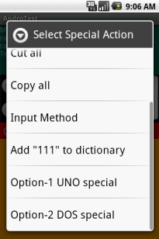
Menus
Another App Using Menus that include Icons & Text : Example - 3
This custom layout (main1.xml) is used to show the ListViewrows (shown as red rows – big font )
Menu Using Icons & Text
//this is a floating context menu that appears when user
//clicks down for a while (about 2 sec) on the textbox or list
@Override
Public void onCreateContextMenu(ContextMenumenu, View v,
ContextMenuInfomenuInfo) {
super.onCreateContextMenu(menu, v, menuInfo);
//add a couple of options to the context menu
menu.setHeaderTitle("Select Special Action");

Slide 65
Menus
Another App Using Menus that include Icons & Text : Example - 3
This custom layout (main1.xml) is used to show the ListViewrows (shown as red rows – big font )
Menu Using Icons & Text
menu.add(0, PICK1, Menu.NONE, "Option-1 UNO special");
menu.add(0, PICK2, Menu.NONE, "Option-2 DOS special");
}//onCreateContextMenu
}

Slide 66
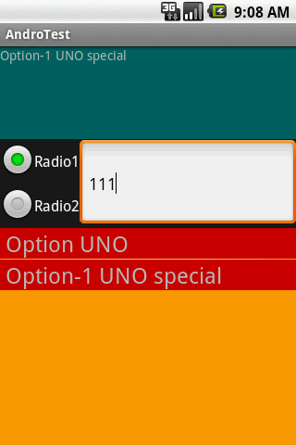
Menus
Another App Using Menus that include Icons & Text : Example - 3
This custom layout (main1.xml) is used to show the ListViewrows (shown as red rows – big font )
Menu Using Icons & Text
// selecting options from the context menu
@Override
Public boolean onContextItemSelected(MenuItemitem) {
super.onContextItemSelected(item);
String msg= item.getTitle().toString();
text0.setText(msg);
arrOptions.add(msg);
adaOptions.notifyDataSetChanged();
returnfalse;
}//onContextItemSelected

Slide 67
Menus
Comments on Creating Submenus
Submenus are displayed as regular Menus Items. When selected they just display more options.
To avoid cluttered UIs, submenus are not displayed using three-like structure, instead they appear as a simple floating window presenting a list of items.
Android does not support nested submenus.

Slide 68
Menus
Comments on Creating Submenus: Example
Extend previous example by adding a fifth entry to the existing menu list. The new entry is of the SubMenu type. It should offer three options of its own.
// adding a sub-menu as fifth entry of this menu
SubMenumySubMenu5 = menu.addSubMenu(0, 0, Menu.NONE, "Sub-Menu-CINCO");
mySubMenu5.setHeaderIcon(R.drawable.cinco);
mySubMenu5.setIcon(R.drawable.cinco);
MenuItemsub51 = mySubMenu5.add(0,0,Menu.NONE,"Sub Menu 5-1");
MenuItemsub52 = mySubMenu5.add(0,0,Menu.NONE,"Sub Menu 5-2");
MenuItemsub53 = mySubMenu5.add(0,0,Menu.NONE,"Sub Menu 5-3");
Note: add this code to the end of the: onCreateOptionsMenu(…)method.

Slide 69
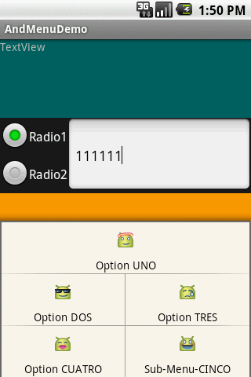
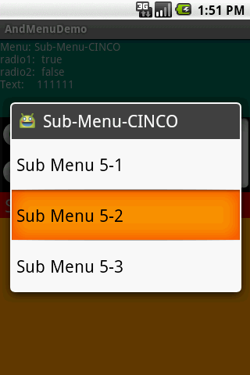
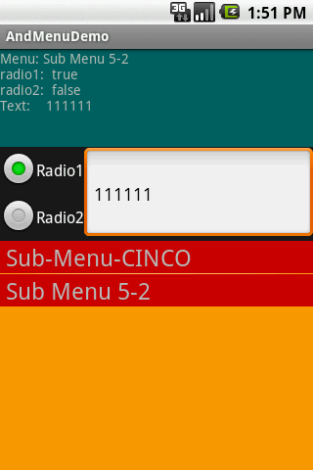
Menus
Comments on Creating Submenus: Example
Extend previous example by adding a fifth entry to the existing menu list. The new entry is of the SubMenu type. It should offer three options of its own.

